Slide 1
Meeting 17/08/2020
Naudé Conradie
19673418

Slide 2
CPPNs
Variable | Parameter | Description | Example Value
mod_n | Number of models | The number of models generated | 1
n_n | Number of nodes | The number of nodes in each layer | 32
hl_n | Number of hidden layers | The number of hidden layers in the network | 32
x | Number of elements in the x-direction |  | 7
y | Number of elements in the y-direction |  | 7
scale | Scale | The scale of the zoom into the model produced | 1
af_n | Number of activation functions | The number of activation functions applied to all layers | 4
seed | The random generation seed |  | i
threshold | Rounding threshold | The rounding threshold applied to the final model to reduce it to a binary grid | 0,5

Slide 3
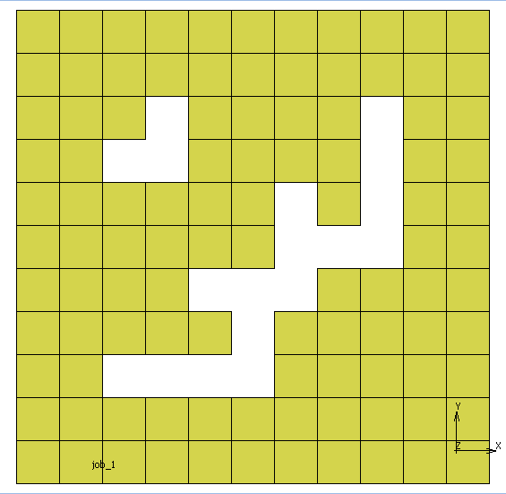
CPPN Examples
Parameter | Value
Seed | 129
Activation functions | Sin Cos Sigmoid Cos ReLu

Slide 4
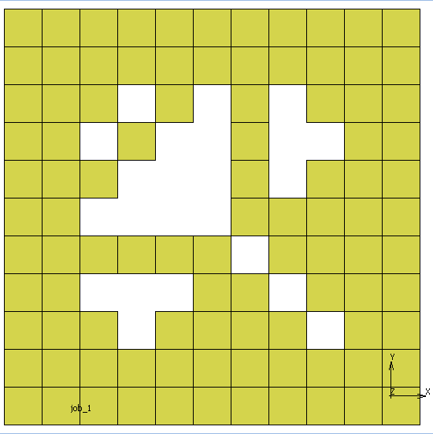
CPPN Examples
Parameter | Value
Seed | 127
Activation functions | Cos Tanh Sin Cos ReLu

Slide 5
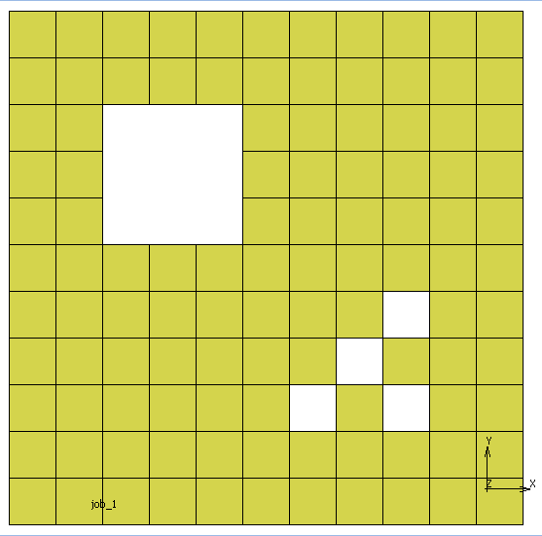
CPPN Examples
Parameter | Value
Seed | 119
Activation functions | Tanh Sin Tanh Tanh Sigmoid

Slide 6
Admin
Lab Work
Discussed with Mr. Roux
Writing
Graphs

